Slide 1
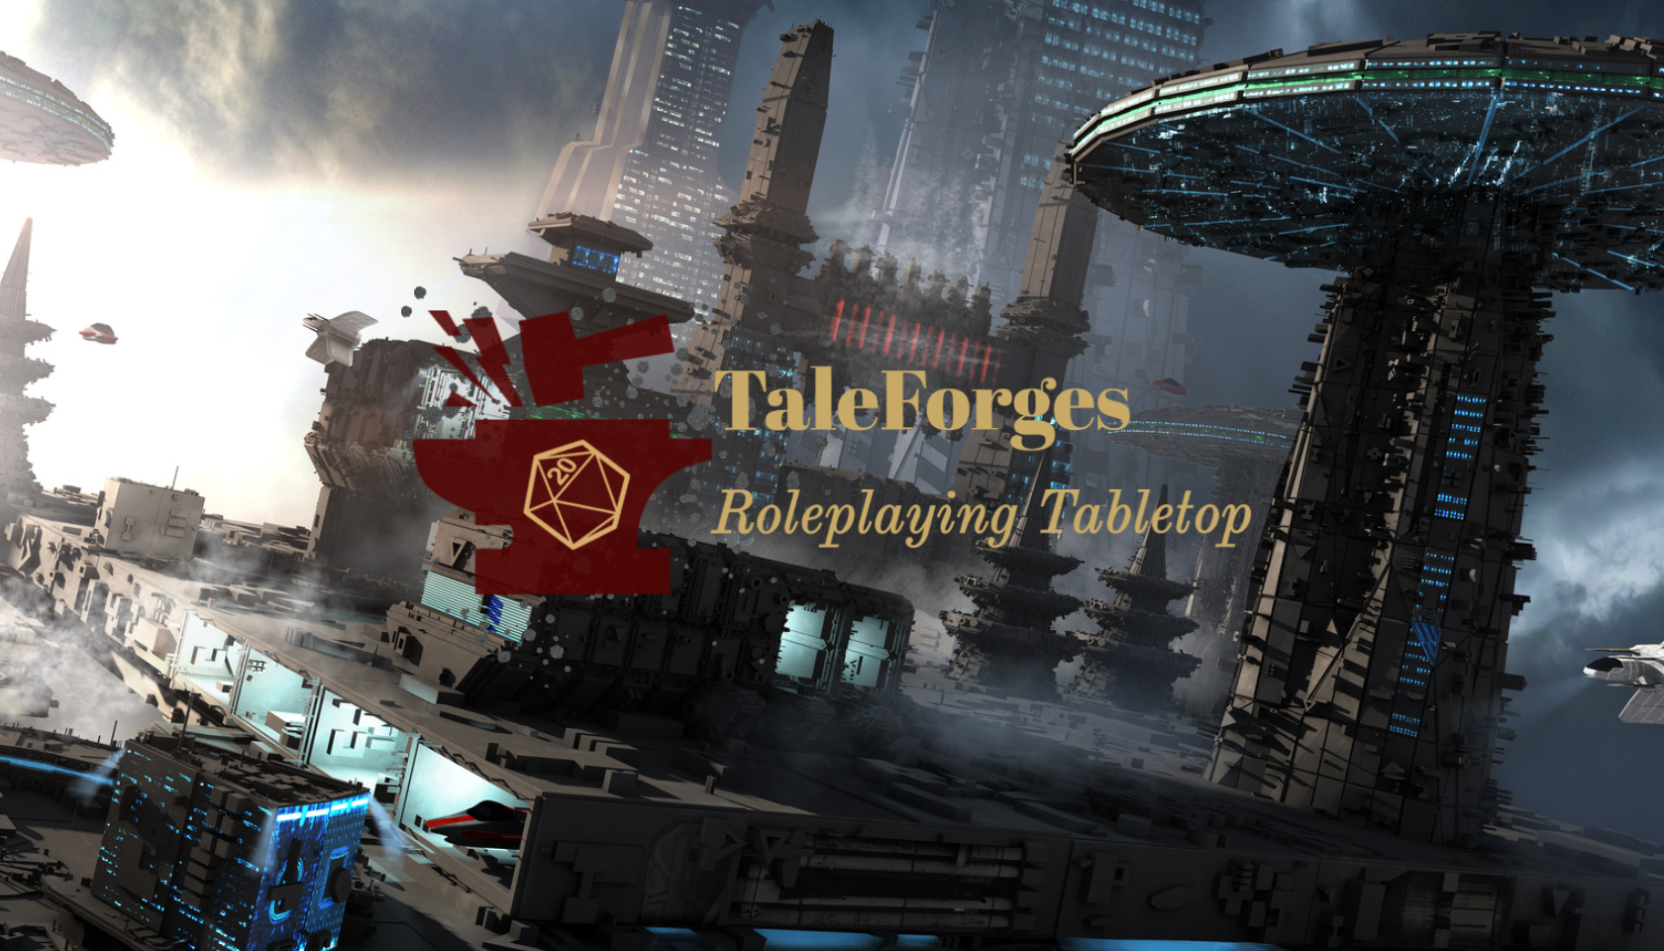

Slide 2
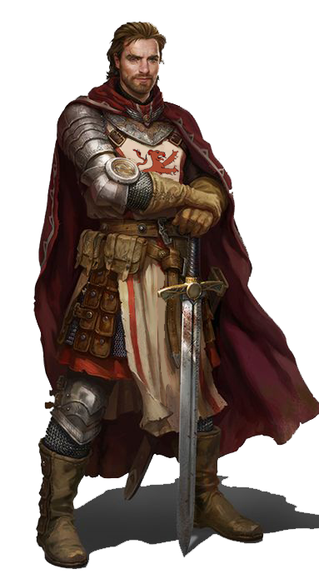
Business Overview

Slide 3
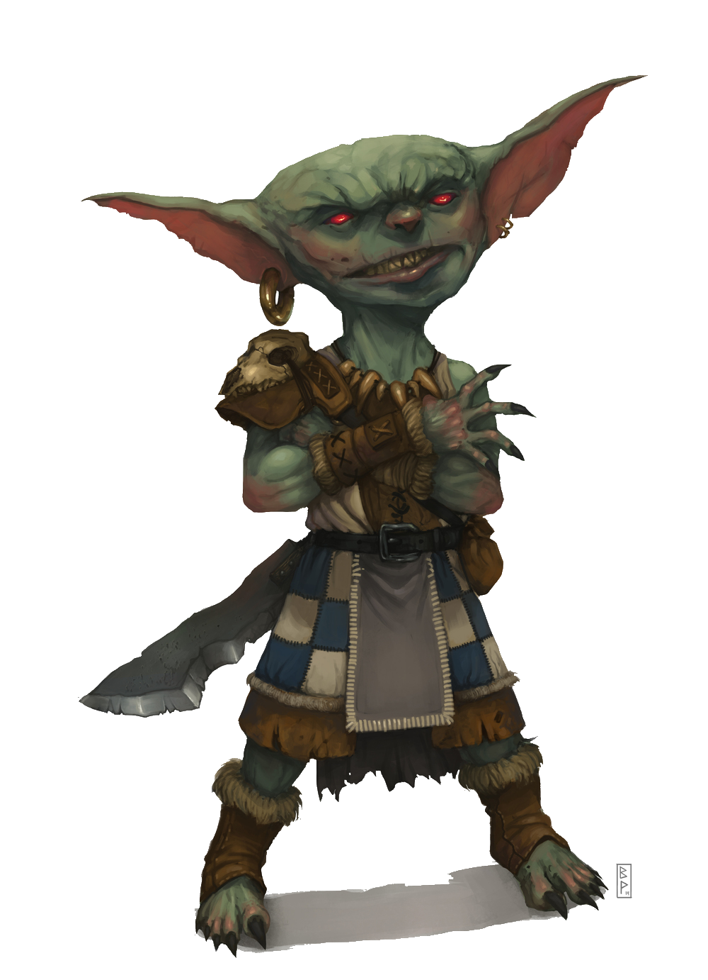
Purpose
Our purpose is to give you an entire platform where you can make your dreams come true, whatever game system you like such as Dragon & Dungeons, Lord of The Ring, Star Wars, and others, we offer you a space with plenty of tools and utilities for the design your world and unique campaigns and let the magic happen with your friends and fellows. Let us do the hard work and you only enjoy these experiences through our platform gamified.
Our goal is to gamify your player experience through the gamification of the website, providing elements and mechanics of video games that provide a unique game environment.

Slide 4
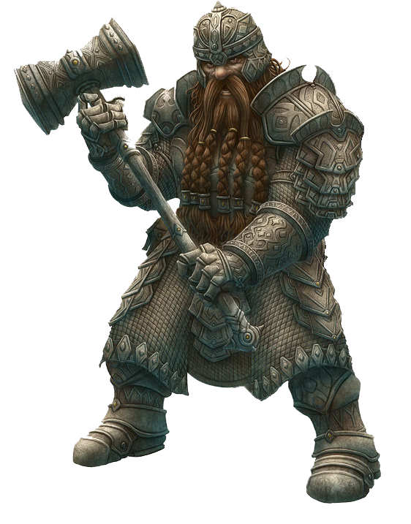
Approach
TaleForges is an online platform created so that you can live a unique experience in online role-playing games, you can not only create your adventures and direct them, but create vast worlds, captivating stories, unique characters, and all kinds of things that your imagination allows you. We give you all the tools, creators of maps and cities, dice of all kinds and even customize your own, databases with all kinds of weapons and armor, magic and spells, professions, names, vehicles, ships, and finally all kinds of elements that will make your experience something incredible.
TaleForges is designed to retain users through playful activities typical of the human being. And we poured that life experience into the platform. We want you to have fun but at the same time grow and gain new skills in the best way than playing role-playing games, and this is not offered by any of the other similar sites.

Slide 5
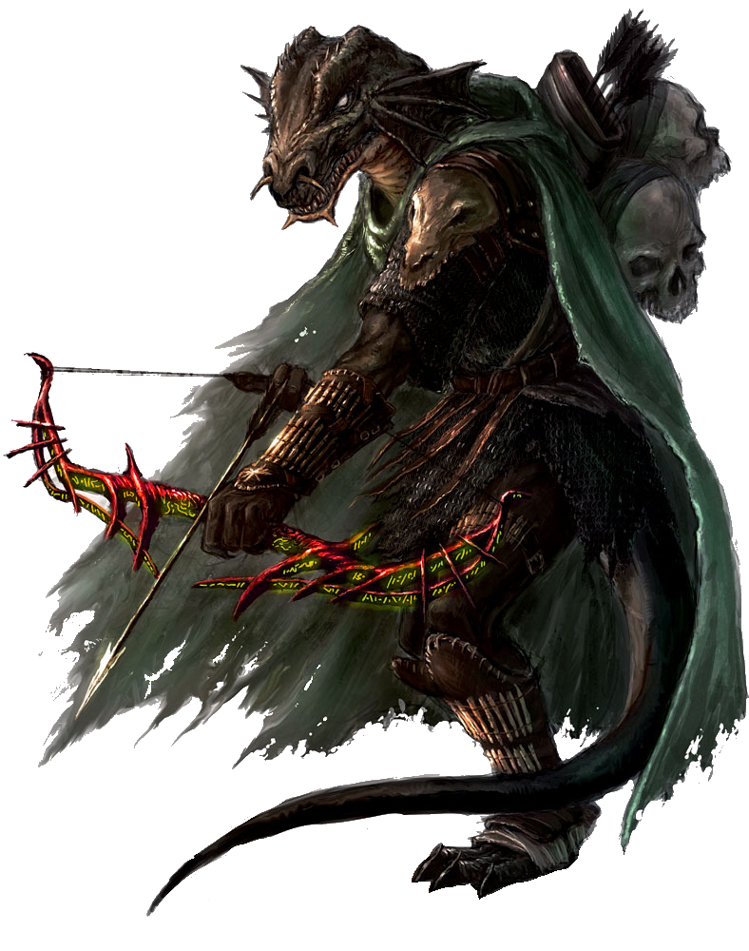
Customer
The site is fully oriented to Role-Playing games players and new ones who will discover a new world in immersive games with many hours of fun and fast-paced adventures as well as a place to make friends and forge together vibrant online stories.
The objective of the activities is to give you a space where you can play role-playing games with your friends or with new players by publishing your campaign and you can not only have fun but also gain new skills, talents, and knowledge that will be useful not only here but in your daily life. Planning, organizing, creating, and managing a group of people and keeping the story of your campaigns always attractive will require all the experience you have and that you will earn in TaleForges. Not only are you going to have fun but you're going to learn new things.

Slide 6

Values
Our values and culture are our Family, Friends, and make new ones. Growing up with new knowledge and opportunities with passion, effort, fun, and learning playing.

Slide 7
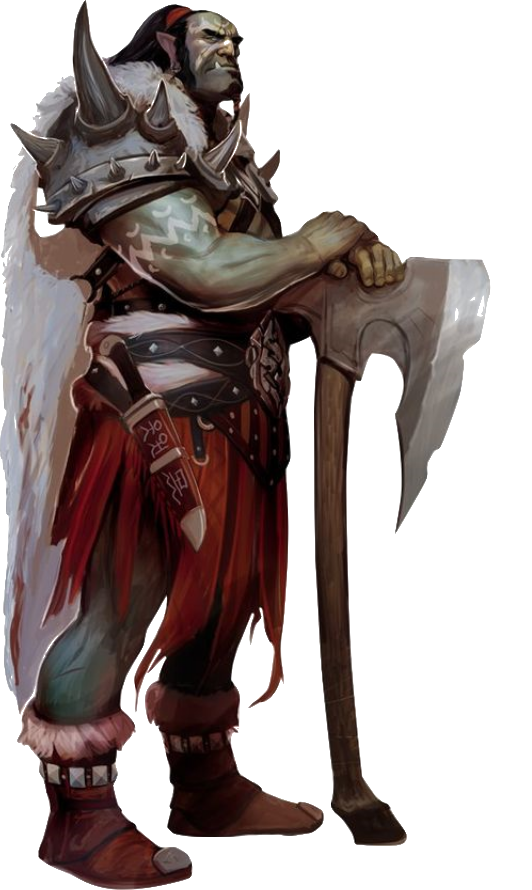
Design Elements

Slide 8
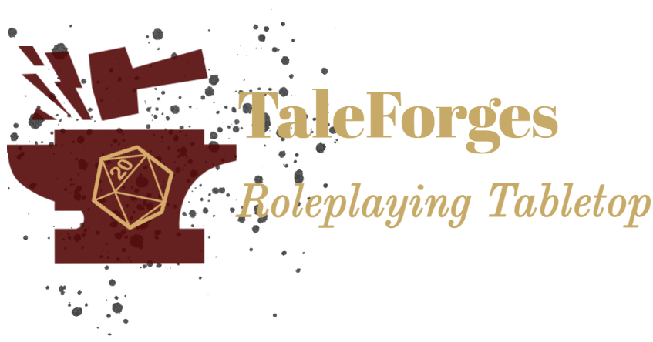
LOGO

Slide 9
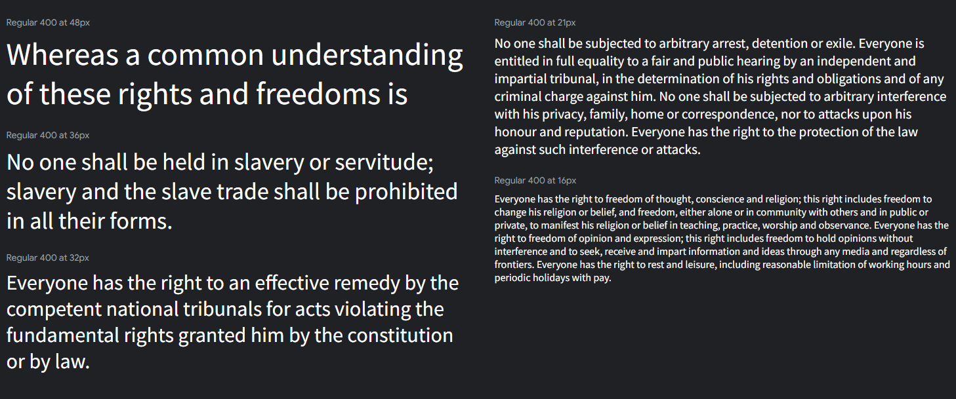
TYPOGRAPHY
Heading Font: [Source Sans Pro]
Paragraph Font: [Source Sans Pro]

Slide 10
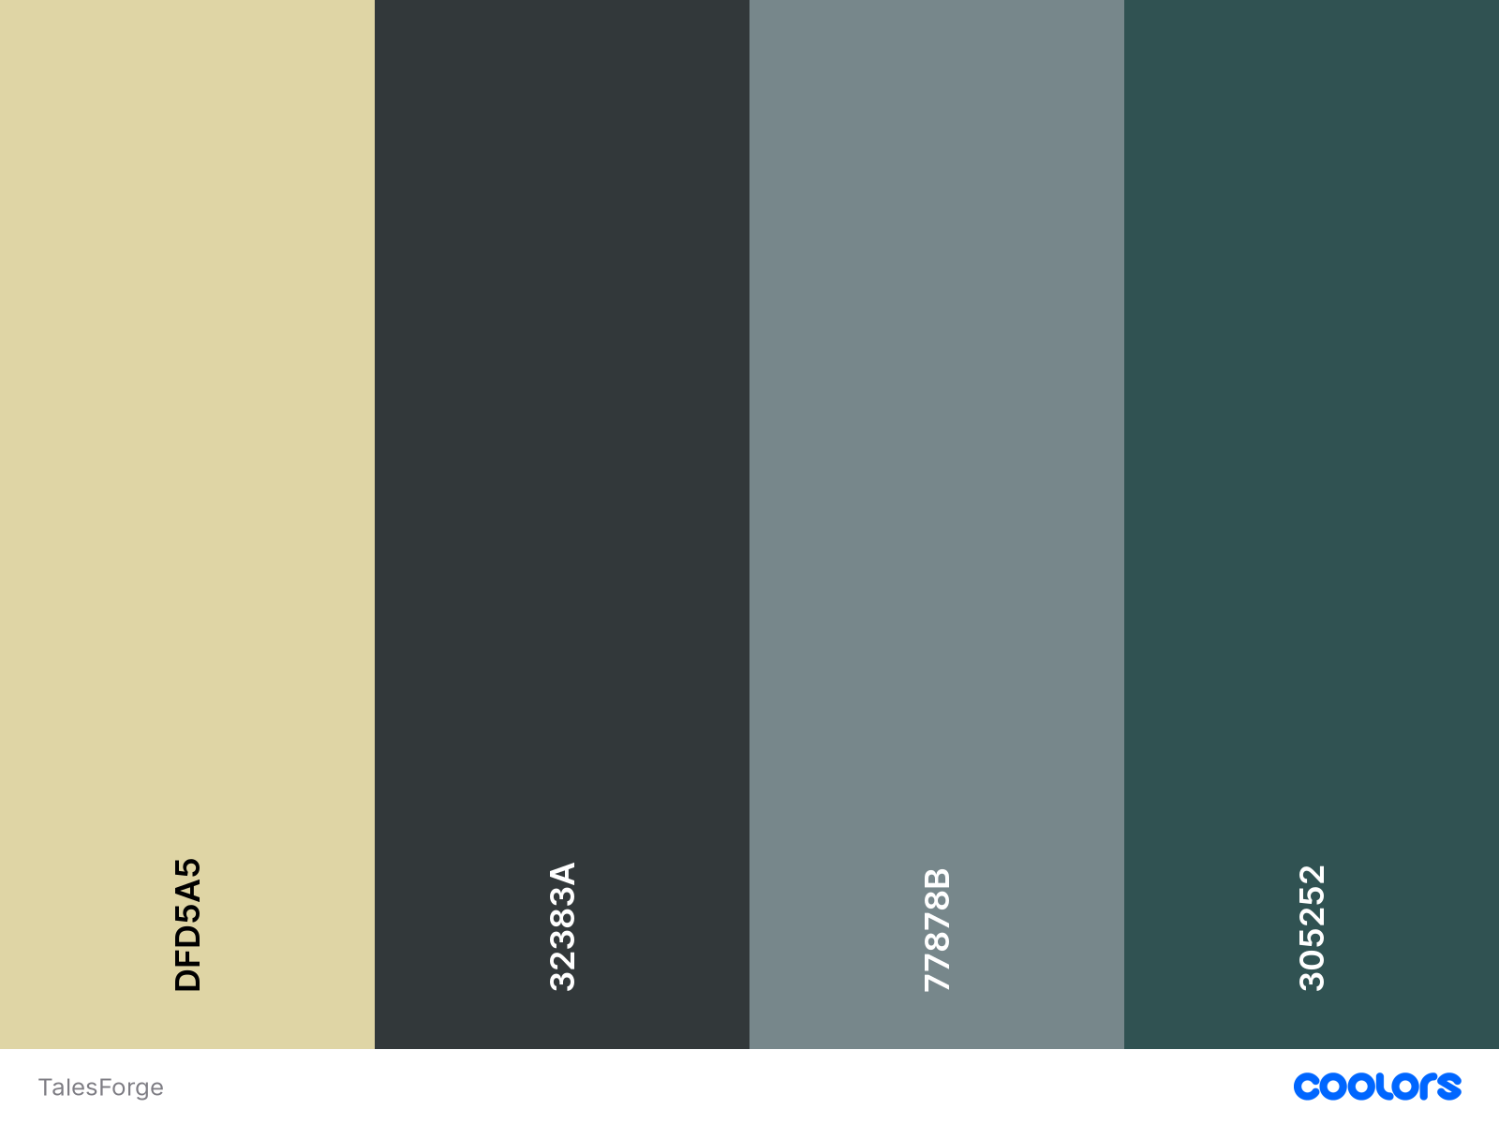
COLOR PALETTES

Slide 12
